Slide 1
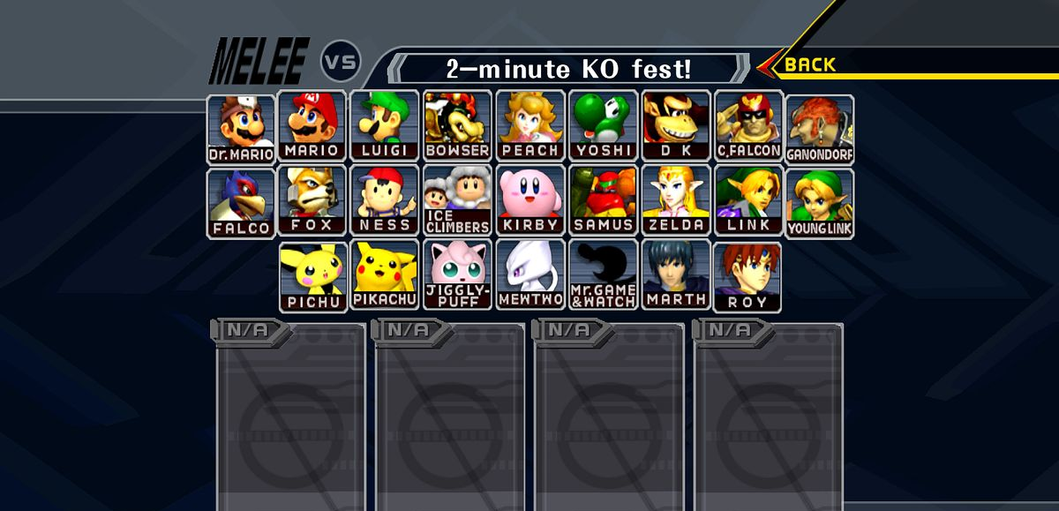
Smash Script
Hunter Mast
This Photo by Unknown Author is licensed under CC BY-SA

Slide 2
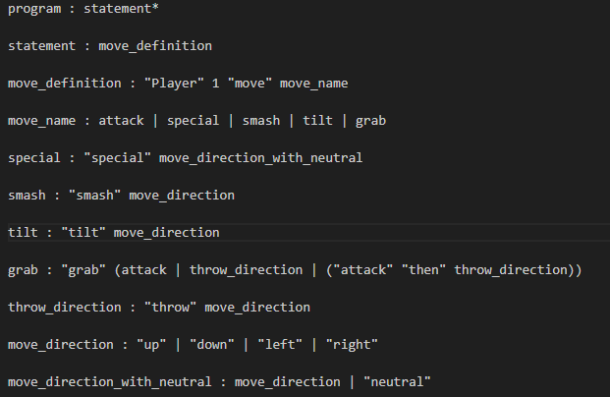
Grammar

Slide 3
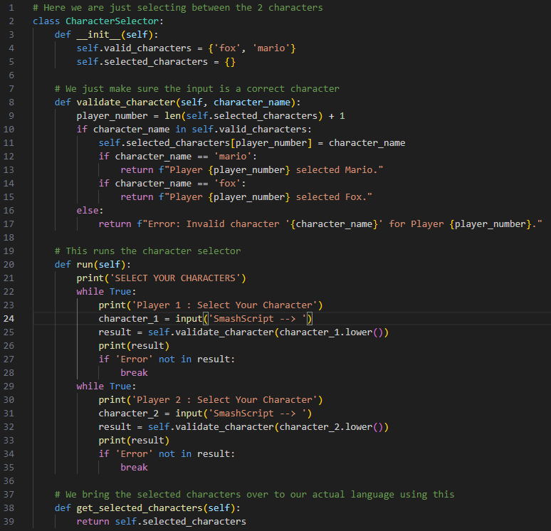
Character selector

Slide 4
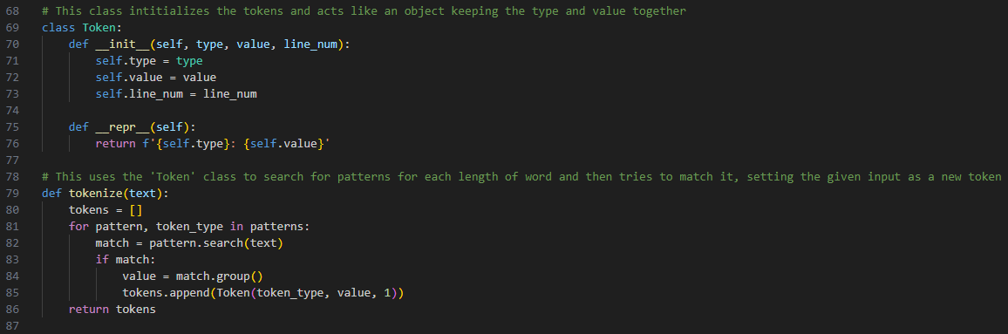
Lexer

Slide 5
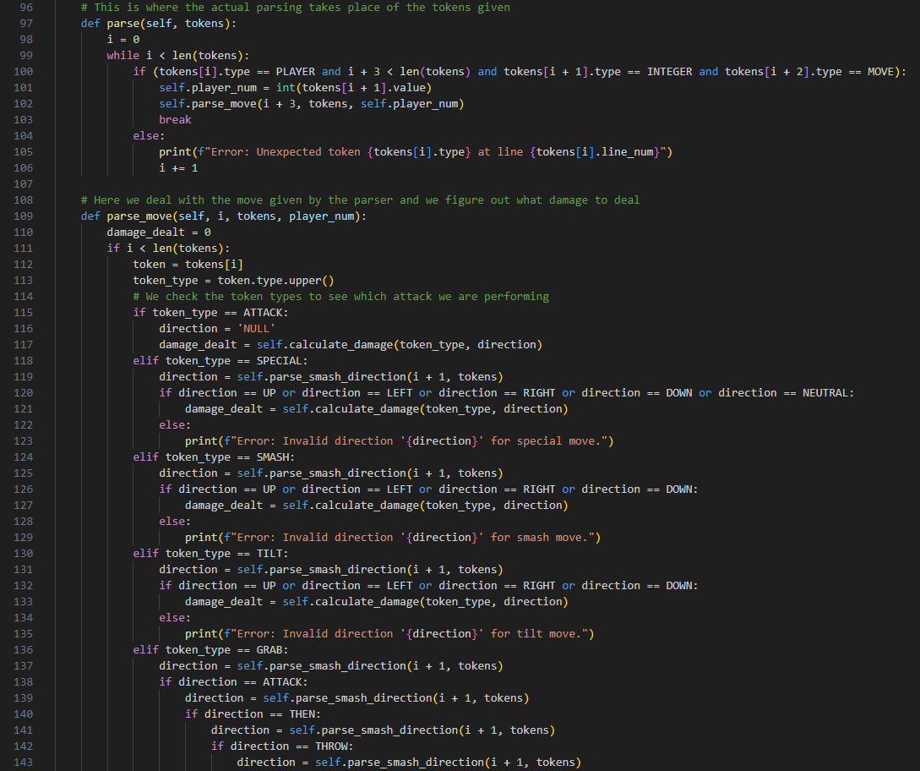
Parsing

Slide 6
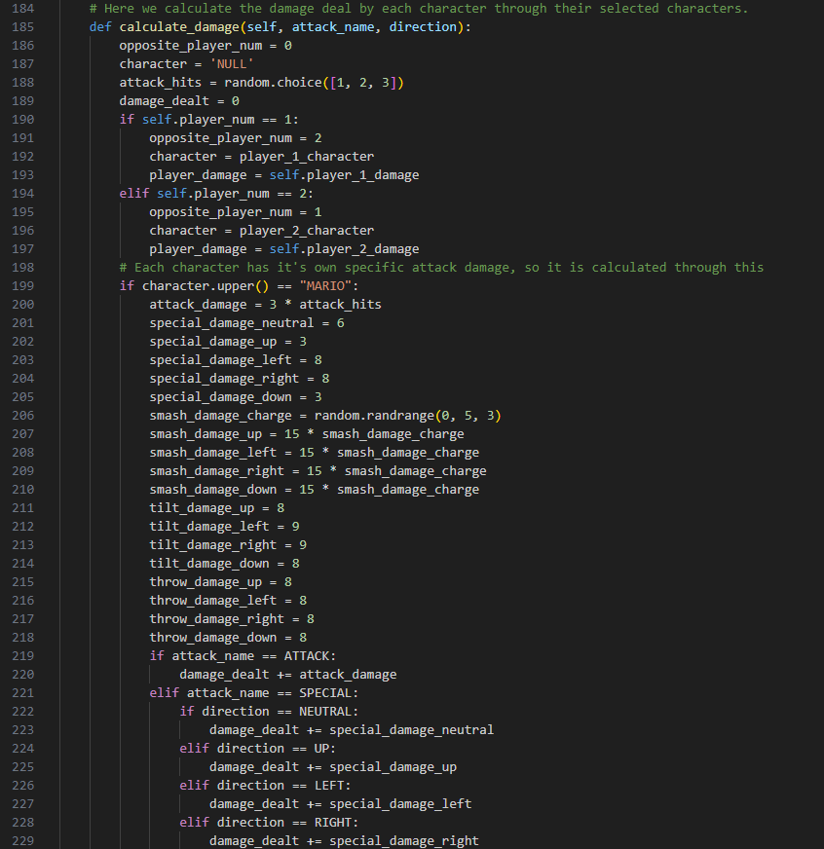
Damage Calculation

Slide 7
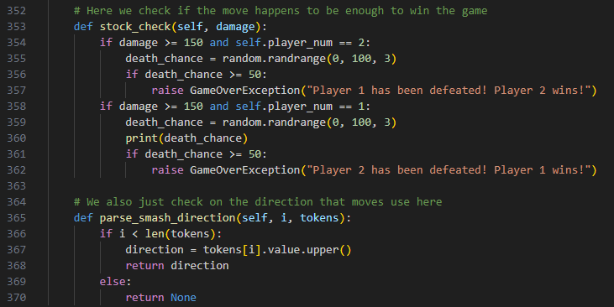
Win Conditions

Slide 8
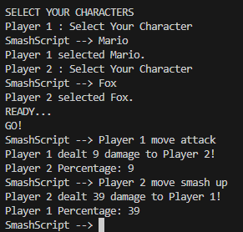
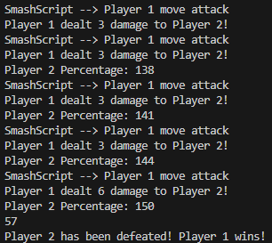
results

Slide 9
Thank You
This Photo by Unknown Author is licensed under CC BY-SA

